Slide 1
CHAPTER 4: Strategic Actions in Establishing Breast Cancer Screening and Implementation Framework
Chapter Four:
DISSEMINATION OF BREAST CANCER ACTION PLAN

Slide 2
OUTLINE
Establishing a Breast Cancer Screening and Early Diagnosis Service
Essential supply needs for screening & early diagnosis service provision
Essential Human Resource Needs for Breast Cancer Screening
Rapid Diagnostic Breast Clinic for Symptomatic Women
Medical Devices for Breast Cancer Surgery
Planned Activities
Key Result Areas
Implementation Matrix

Slide 3
Essential Supply Needs for Breast Cancer Screening & Early Diagnosis Service Provision
1. CBE
Screens for privacy
Water & soap for handwashing/ sanitizer
Clean gloves
Examining table and bed-spread (consider disposable sheet cover roll)
Adequate lighting
Job aid
Stationery

Slide 4
Essential Supply Needs for Breast Cancer Screening & Early Diagnosis Service Provision… Cont’d
2. Mammography:
Fixed or mobile digital mammography unit.
Appropriate room with radiation protection measures.
Patient privacy: secure exam rooms, gowns, private dressing room and closet.
Reading room: dedicated areas to interpret mammograms.
Electric supply (with back-up system)
Appropriate waste disposal and ablution.
Disinfection/infection prevention and control: handwashing, cleaning, sanitizers.
Proper storage and preservation of images or films*
PAC system with digital scanners for tele-reporting.
Compression devices for additional projections.
Notes:
consider storing images on CDs, cloud storage or PACS

Slide 5
Essential Supply Needs for Breast Cancer Screening & Early Diagnosis Service Provision… Cont’d
3. Other Breast Cancer Devices and Accessories
Procedure | Capital Equipment
Stereotactic guided core needle biopsy of primary tumor or metastatic lesions | Mammographic stereotactic biopsy system (cone compression devices could be used with normal mammographic system) Optional: vacuum-assisted biopsy device and driver.
Ultrasound guided biopsy of regional lymph and sentinel nodes | Biopsy gun. Ultrasound probe or transducer/ Linear array, high-frequency transducers, small-footprint, large bandwidth transducers with central frequency above 10 MHz are ideal
Core needle biopsy | Biopsy Gun
Fine needle aspiration (FNA) | -
Notes:
consider storing images on CDs, cloud storage or PACS

Slide 6
Essential Human Resource Needs for Screening
Mammography staff include:
Radiologist/Interpreting physician – a medical doctor with post-graduate training in radiology (where possible, specializing in breast imaging)
Radiologic technologist: Performs mammographic examinations and prepares films or digitized images for interpretation. Trained and licensed to perform general radiographic procedures.
Medical physicist: Surveys the mammography equipment and oversees equipment-related quality assurance practices of the facility.
Radiation protection officer: Ensures that the HCW and the public are protected from the harmful effects of radiation.
Support staff - clerical staff, data officers and receptionists

Slide 7
Rapid Diagnostic Breast Clinic for Symptomatic Women
Essential staff required to run this Breast Cancer Clinic will include:
Administrative/ support staff
Nursing personnel
Breast clinician
Breast surgeon
Radiologist with interest in breast imaging
Radiographer for imaging procedures
Clinical Pathologist
Cytologist/Histotechnicians
Oncologist
Notes:
Pts presenting with lesions will need to be attended to at rapid diagnostic clinics that provides Triple Assessment services. This is a dedicated specialist breast clinic with infrastructure and staff for same-day imaging and biopsy
Radiologist with interest in breast imaging • Radiographer to perform the imaging procedures

Slide 8
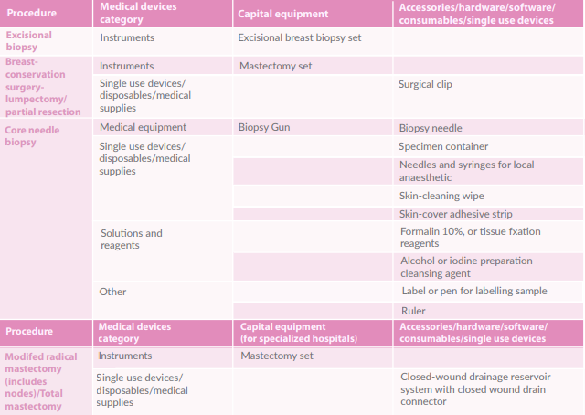
Medical Devices for Breast Cancer Surgery

Slide 9
Planned Activities

Slide 10
Key Result Areas
5 thematic areas to achieve Action Plan objectives:
Governance And Policy.
Demand Creation and Community Education & Engagement
Training and Professional Development
Service Delivery (Screening, Diagnostics, Patient Navigation & Referral).
Monitoring And Evaluation.

Slide 11
Governance & Policy
Establish national and county-level breast cancer early detection governance structures
Identify and sensitize key stakeholders for engagement
Establish a quality assurance and improvement process within an active screening program to monitor key performance indicators.
Mobilize resources to support breast cancer screening and early detection programs
Promote adherence to national clinical guidelines for breast cancer screening, early diagnosis and management

Slide 12
Awareness, Demand Creation and Community Education & Engagement
Development, printing and distribution of information, education and communication materials to all health facilities
Engage Community Health Volunteers to provide information on breast health and breast cancer awareness through dialogue sessions and other fora
Engage & equip key influencer groups (cancer survivors, religious, administrative, community leaders, celebrities, the media/TV personalities and opinion leaders) with advocacy skills for breast cancer awareness
Conduct breast cancer screening mobile clinic outreaches in targeted settings
Create community to facility linkages for breast cancer further assessment and appropriate referral.
Sustained Breast Cancer Awareness campaigns on mainstream, social media and other channels.
Institute breast cancer work place programs that encourage early detection of breast cancer

Slide 13
Training/Professional Development of Health Workforce
Appropriate training of CHVs, CHEWs and Health Promotion Officers on promoting education of early breast cancer signs and symptoms and risk factors and creating accurate breast cancer awareness.
Appropriate training of primary care clinicians, family physicians, gynecologists and surgeons on promoting breast health awareness, self-breast examination, conducting CBEs, point-of-care ultrasounds and appropriate imaging referral.
Appropriate training of imaging personnel on breast imaging techniques including image-guided biopsies.
Appropriate training of laboratory personnel on handling, processing and interpretation of pathology specimens.
Training of health records and information officers and other healthcare workers on breast cancer screening data management.
Integration of breast cancer content in curriculum into Undergraduate and Post Graduate Health Training programs.

Slide 14
Service Delivery (Screening, Diagnostics, Patient Navigation and Referral)
Set up Breast Cancer Centers of Excellence (COEs) at the three (3) National referral Hospitals.
Establish rapid diagnostic units for prompt diagnosis of breast abnormalities in county referral hospitals with provision of histopathology services.
Establish and strengthen hormonal testing (immunohistochemistry for ER/PR/HER2) for breast cancer at the National Cancer Reference Laboratory, National Referral Hospitals and select high volume county referral facilities with regional cancer treatment facilities.
Activate breast cancer screening mammography services in the 47 county referral facilities with digital mammogram machines

Slide 15
Service Delivery (Screening, diagnostics, patient navigation and referral)…cont’d
Establish linkages and referral structures (including psychosocial support) for patients and specimens.
Avail commodities for provision of comprehensive breast cancer services as per level of care
Develop public private partnerships to provide screening and early diagnostic services.
Integrate breast cancer screening services to other screening services, including but not limited to maternal and child health, postnatal, HIV and NCDs management

Slide 16
Monitoring & Evaluation and Research
Develop a clear Monitoring and Evaluation framework for the breast cancer screening program in Kenya, including awareness, with indicators and suggested data sources.
Conduct a baseline, midterm and end term assessment of breast cancer screening and linkage to care.
Strengthen and improve data systems to enable computation and tracking of selected breast cancer screening diagnosis, treatment and follow-up indicators.
Enhance timely monthly reporting of breast cancer indicators and advocating utilization of this information by all stakeholders, including counties.
Identify research priority areas and conduct research to guide breast cancer care across the entire continuum

Slide 17
Implementation matrix structure
Proposed Activities | Sub-activities | Key Performance Indicators | Responsible Persons | 2021 | 2022 | 2023 | 2024 | 2025
Integrate Breast Cancer Prevention, Screening & Early Diagnosis agenda in the national & county-level committees with representation of relevant stakeholders and experts | Sensitization meeting for selected CHMT members and other stakeholders | Number of sensitization meetings held | MOH-NCI-K, NCCP, counties & other stakeholders |  | X | X | X | X
 | Hold quarterly Breast Cancer TWG committee meetings | Minutes of quarterly meetings; Implementation of action items | Breast cancer TWG | X | X | X | X | X
 | Provide technical support on creation & maintenance of county-level committees: membership, TORs & work plans | Technical support provided | Breast Cancer TWG, Counties |  | X | X | X | X

Slide 18
Summary – Take Home Message
Essential needs for establishing a breast cancer screening and early diagnosis service include supplies for CBE, mammography, diagnostics & surgery
Rapid Diagnostic Breast Clinics are key for symptomatic women
Implementation matrix for activities under each key result area outlined with Key Performance Indicators and assigned responsibilities

Slide 19
Thank You!
Call to action to beat breast cancer – What will you do?

